Slide 1
MIDS W205 Instructor: Shiraz Chakraverty Fall 2021, Tue 6.30 P.M. Section Project 3
Team Name:
“The Low Stress Express” Team Members: Aastha Khanna, Ben Mok, Don Irwin, Lise Lindquist, Theresa Kuruvilla
MIDS 2021 Fall, W205 Project 3 The Low Stress Express
Notes:
Worker attrition is measured by participants moving between companies during the study. Worker productivity is revenue per hour of worker labor. Worker satisfaction will be measured by surveys before and after. Risks include changes to indexes of productivity, or retention due to mergers, recessions, etc. …

Slide 2
Project Objectives: Demonstrate understanding of, and the ability to create the following:
Docker based containerization.
Docker virtual networks.
API endpoints (Python Flask in this case).
Message broker services (Kafka and Zookeeper).
Transformation Engines (Spark).
Persistent distributed redundant query-able store (HDFS).
Hive SQL tables.
Synthetic Parameterized Event Generation.
Event Transformation.
Persist streaming events.
Schema organization.
Report generation at tail end of pipeline
Make the process re-producible.
MIDS 2021 Fall, W205 Project 3 The Low Stress Express
Notes:
Worker attrition is measured by participants moving between companies during the study. Worker productivity is revenue per hour of worker labor. Worker satisfaction will be measured by surveys before and after. Risks include changes to indexes of productivity, or retention due to mergers, recessions, etc. …

Slide 3
Pull and Run Pipeline from Code Repository
Commentary on industry at this point: Code Demos Simple Powerpoints Infrastructure as code Questionable utility of Project Manager roles in Startups and core competency groups. Executive teams’ increasing appetite for code demos, and waning appetites for powerpoints, burndowns and verbal update meetings.
Start The Process. cd ~/w205/ . low_stress_express.sh
MIDS 2021 Fall, W201 Project 2 The Low Stress Express
Notes:
Worker attrition is measured by participants moving between companies during the study. Worker productivity is revenue per hour of worker labor. Worker satisfaction will be measured by surveys before and after. Risks include changes to indexes of productivity, or retention due to mergers, recessions, etc. …

Slide 4
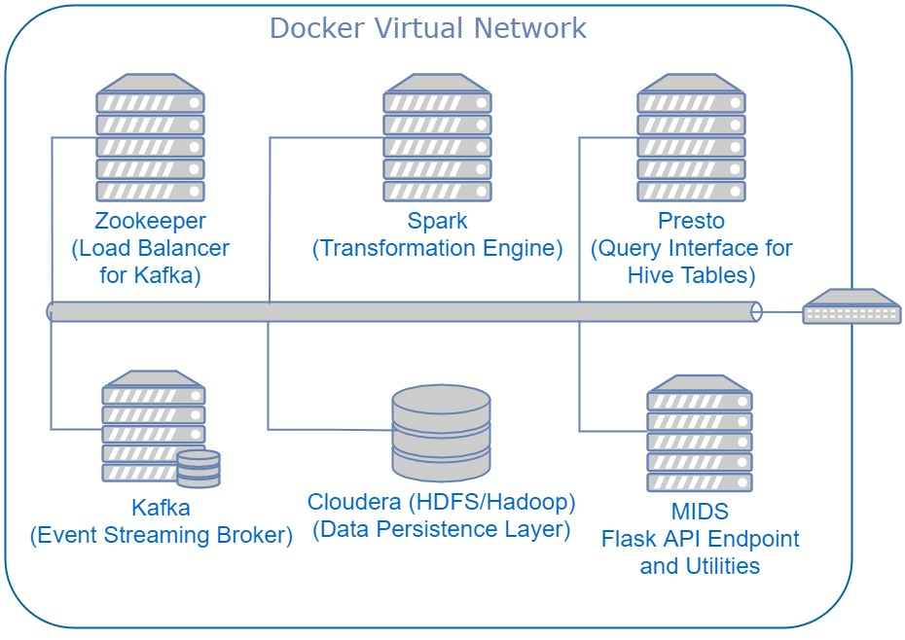
Infrastructure as Code – The YML File
--- version: '2' services: redis: image: redis:latest expose: - "6379" zookeeper: image: confluentinc/cp-zookeeper:latest environment: ZOOKEEPER_CLIENT_PORT: 32181 ZOOKEEPER_TICK_TIME: 2000 expose: - "2181" - "2888" - "32181" - "3888" extra_hosts: - "moby:127.0.0.1" kafka: image: confluentinc/cp-kafka:latest depends_on: - zookeeper environment: KAFKA_BROKER_ID: 1 KAFKA_ZOOKEEPER_CONNECT: zookeeper:32181 KAFKA_ADVERTISED_LISTENERS: PLAINTEXT://kafka:29092 KAFKA_OFFSETS_TOPIC_REPLICATION_FACTOR: 1 expose: - "9092" - "29092" extra_hosts: - "moby:127.0.0.1" | cloudera: image: midsw205/hadoop:0.0.2 hostname: cloudera expose: - "8020" # nn - "8888" # hue - "9083" # hive thrift - "10000" # hive jdbc - "50070" # nn http ports: - "8888:8888" - "9093" extra_hosts: - "moby:127.0.0.1" volumes: - ~/w205:/w205 spark: image: midsw205/spark-python:0.0.6 stdin_open: true tty: true volumes: - ~/w205:/w205 expose: - "8888" #ports: # - "8888:8888" depends_on: - cloudera environment: HADOOP_NAMENODE: cloudera HIVE_THRIFTSERVER: cloudera:9083 extra_hosts: - "moby:127.0.0.1" command: bash | presto: image: midsw205/presto:0.0.1 hostname: presto volumes: - ~/w205:/w205 expose: - "8080" ports: - "8082:8080" # Adding binding to local port 8082 for connection from notebooks; 8080 was in use environment: HIVE_THRIFTSERVER: cloudera:9083 extra_hosts: - "moby:127.0.0.1" mids: image: midsw205/base:0.1.9 stdin_open: true tty: true volumes: - ~/w205:/w205 expose: - "5000" ports: - "5000:5000" extra_hosts: - "moby:127.0.0.1" command: jupyter notebook --no-browser --port 8888 --ip 0.0.0.0 --allow-root
MIDS 2021 Fall, W201 Project 2 The Low Stress Express
Notes:
Worker attrition is measured by participants moving between companies during the study. Worker productivity is revenue per hour of worker labor. Worker satisfaction will be measured by surveys before and after. Risks include changes to indexes of productivity, or retention due to mergers, recessions, etc. …

Slide 5
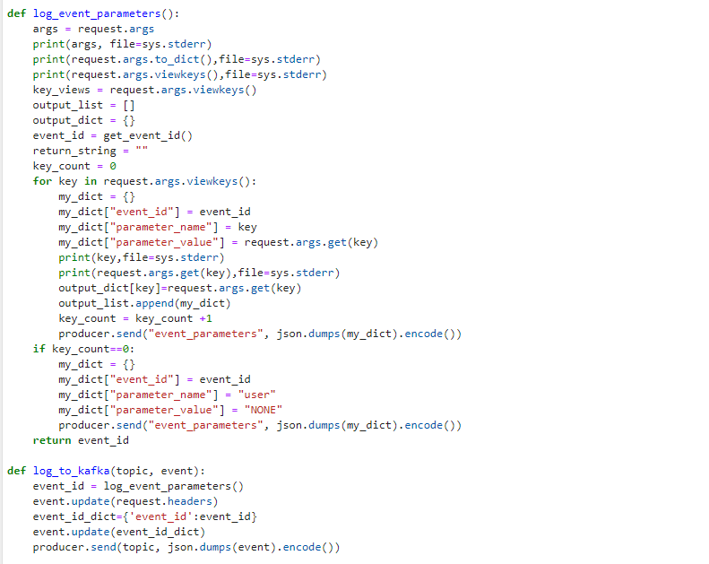
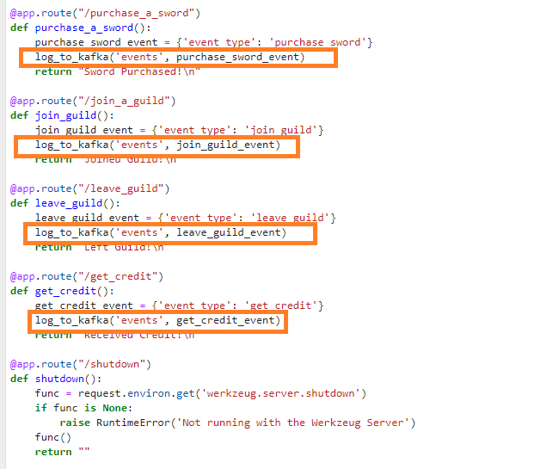
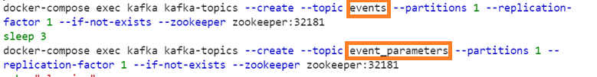
Kafka Topic Creation and API Definition
MIDS 2021 Fall, W201 Project 2 The Low Stress Express
Notes:
Worker attrition is measured by participants moving between companies during the study. Worker productivity is revenue per hour of worker labor. Worker satisfaction will be measured by surveys before and after. Risks include changes to indexes of productivity, or retention due to mergers, recessions, etc. …

Slide 6
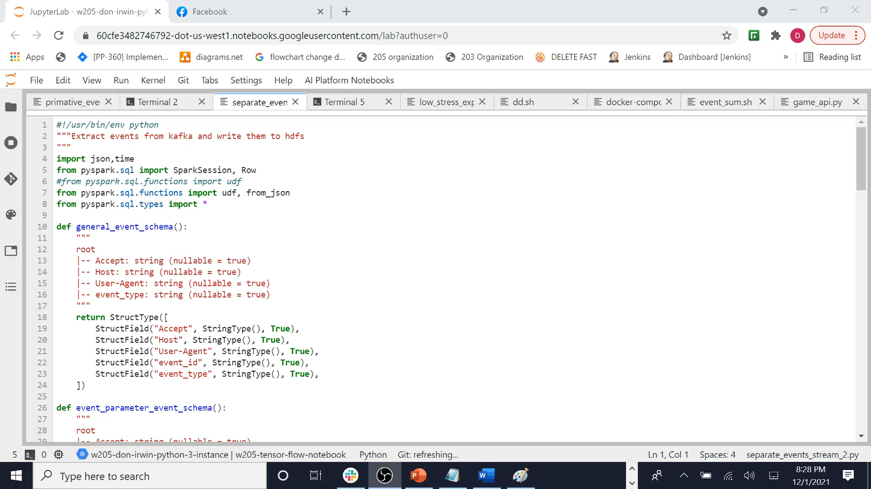
Streaming Event Transformation and Presistence
MIDS 2021 Fall, W201 Project 2 The Low Stress Express
Notes:
Worker attrition is measured by participants moving between companies during the study. Worker productivity is revenue per hour of worker labor. Worker satisfaction will be measured by surveys before and after. Risks include changes to indexes of productivity, or retention due to mergers, recessions, etc. …

Slide 7
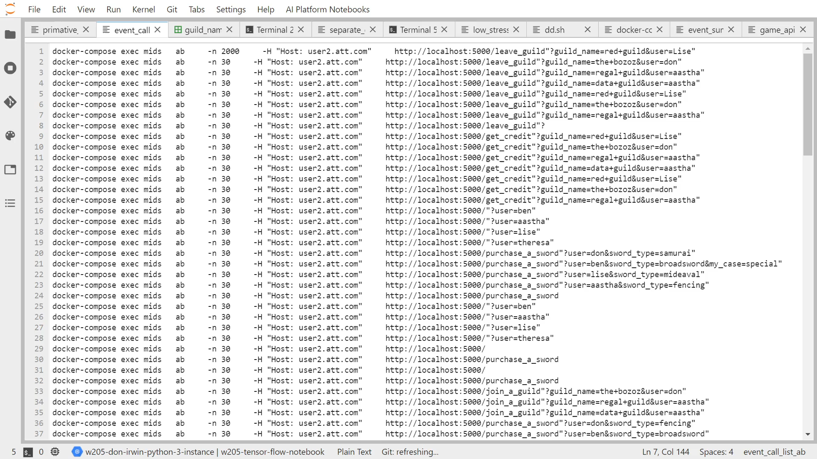
Synthetic Parameterized Event Generation
We want to dynamically generate these types of calls: docker-compose exec mids ab -n 30 -H "Host: user2.att.com" http://localhost:5000/purchase_a_sword"?user=ben&sword_type=broadsword"
MIDS 2021 Fall, W201 Project 2 The Low Stress Express
Notes:
Worker attrition is measured by participants moving between companies during the study. Worker productivity is revenue per hour of worker labor. Worker satisfaction will be measured by surveys before and after. Risks include changes to indexes of productivity, or retention due to mergers, recessions, etc. …

Slide 8
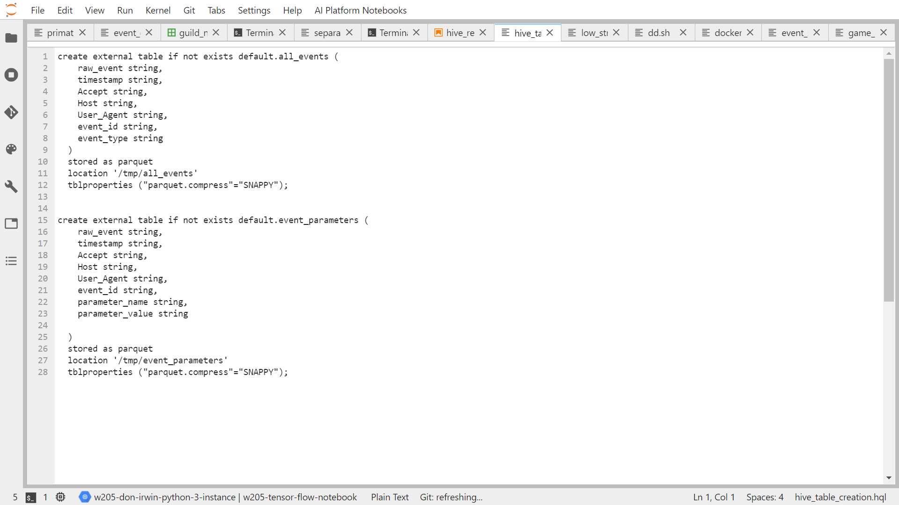
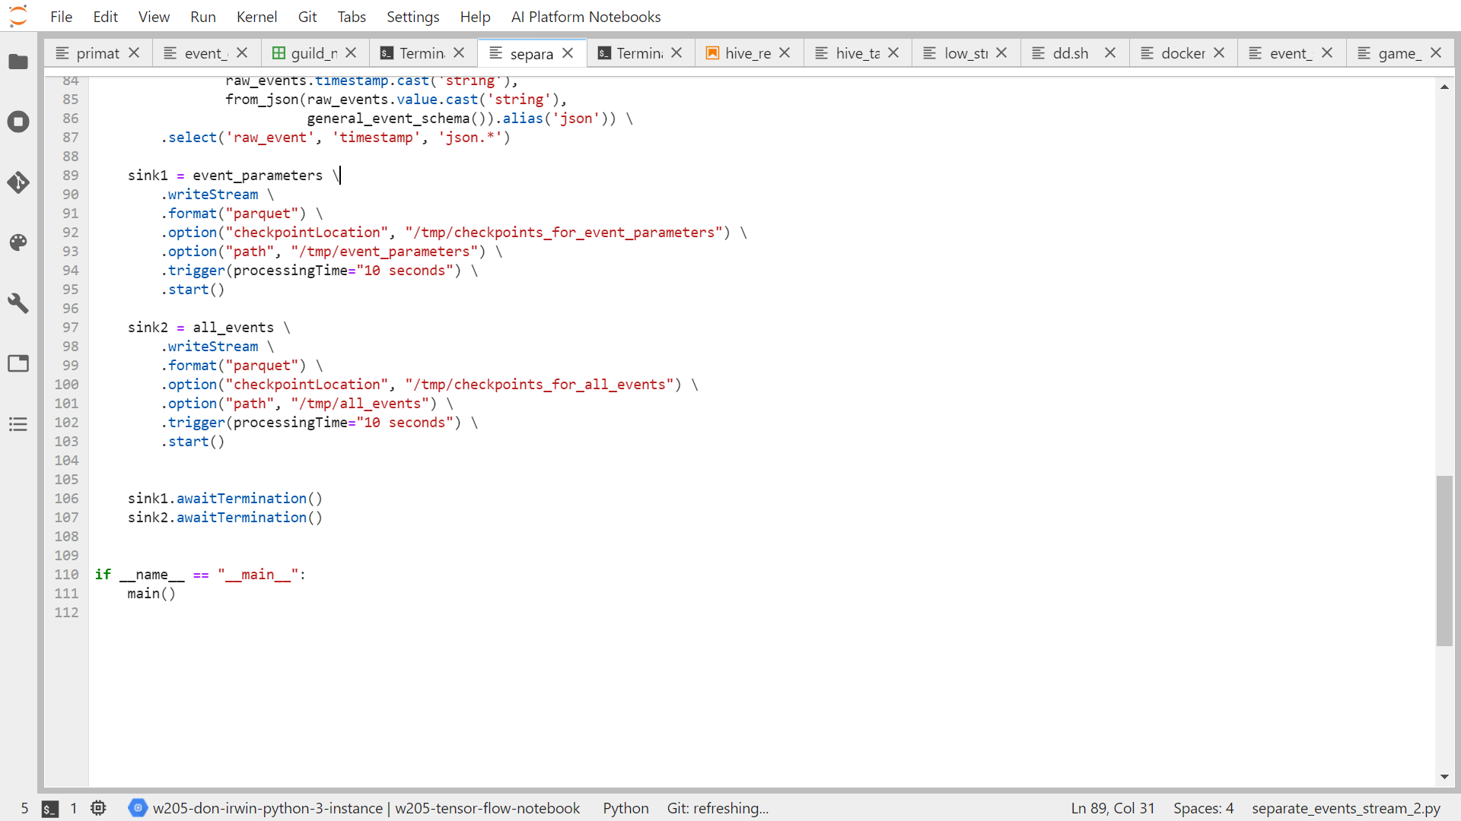
Defining Hive Tables
Let’s review our Spark Streaming sink definitions:
We will now create Hive tables by binding to the files we’ve defined in our streaming transformation.
MIDS 2021 Fall, W201 Project 2 The Low Stress Express
Notes:
Worker attrition is measured by participants moving between companies during the study. Worker productivity is revenue per hour of worker labor. Worker satisfaction will be measured by surveys before and after. Risks include changes to indexes of productivity, or retention due to mergers, recessions, etc. …

Slide 9
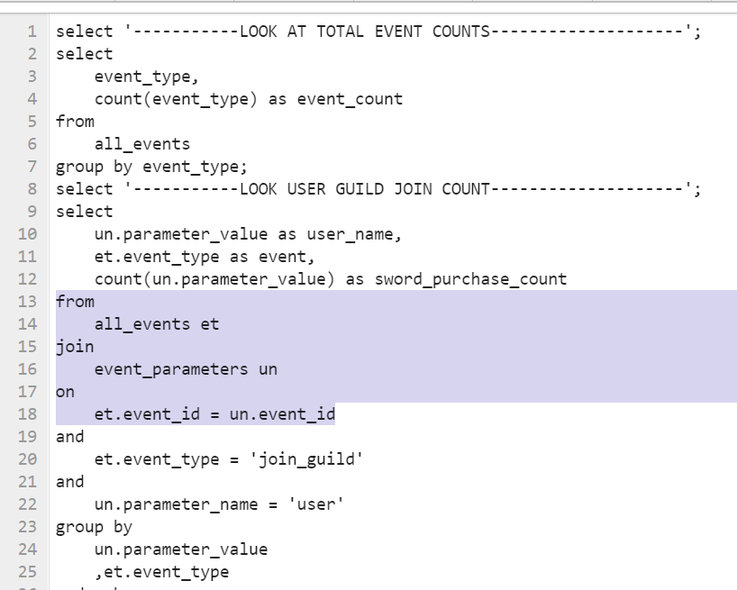
Querying Hive Tables
We can now create complex queries to get information our of the tables we’ve defined through using Hive SQL and joining them as we wish.
MIDS 2021 Fall, W201 Project 2 The Low Stress Express
Notes:
Worker attrition is measured by participants moving between companies during the study. Worker productivity is revenue per hour of worker labor. Worker satisfaction will be measured by surveys before and after. Risks include changes to indexes of productivity, or retention due to mergers, recessions, etc. …

Slide 10
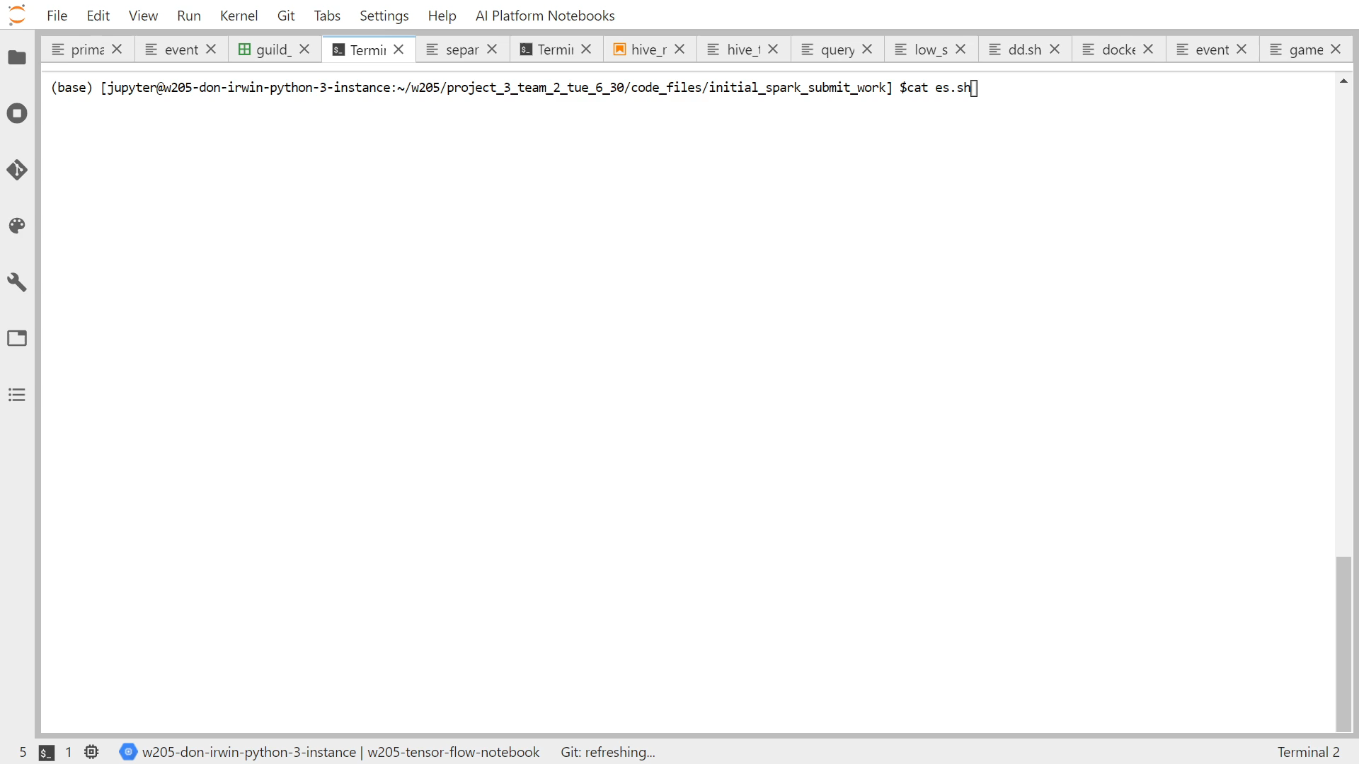
Querying Hive Tables – Command Prompt
MIDS 2021 Fall, W201 Project 2 The Low Stress Express
Notes:
Worker attrition is measured by participants moving between companies during the study. Worker productivity is revenue per hour of worker labor. Worker satisfaction will be measured by surveys before and after. Risks include changes to indexes of productivity, or retention due to mergers, recessions, etc. …

Slide 11
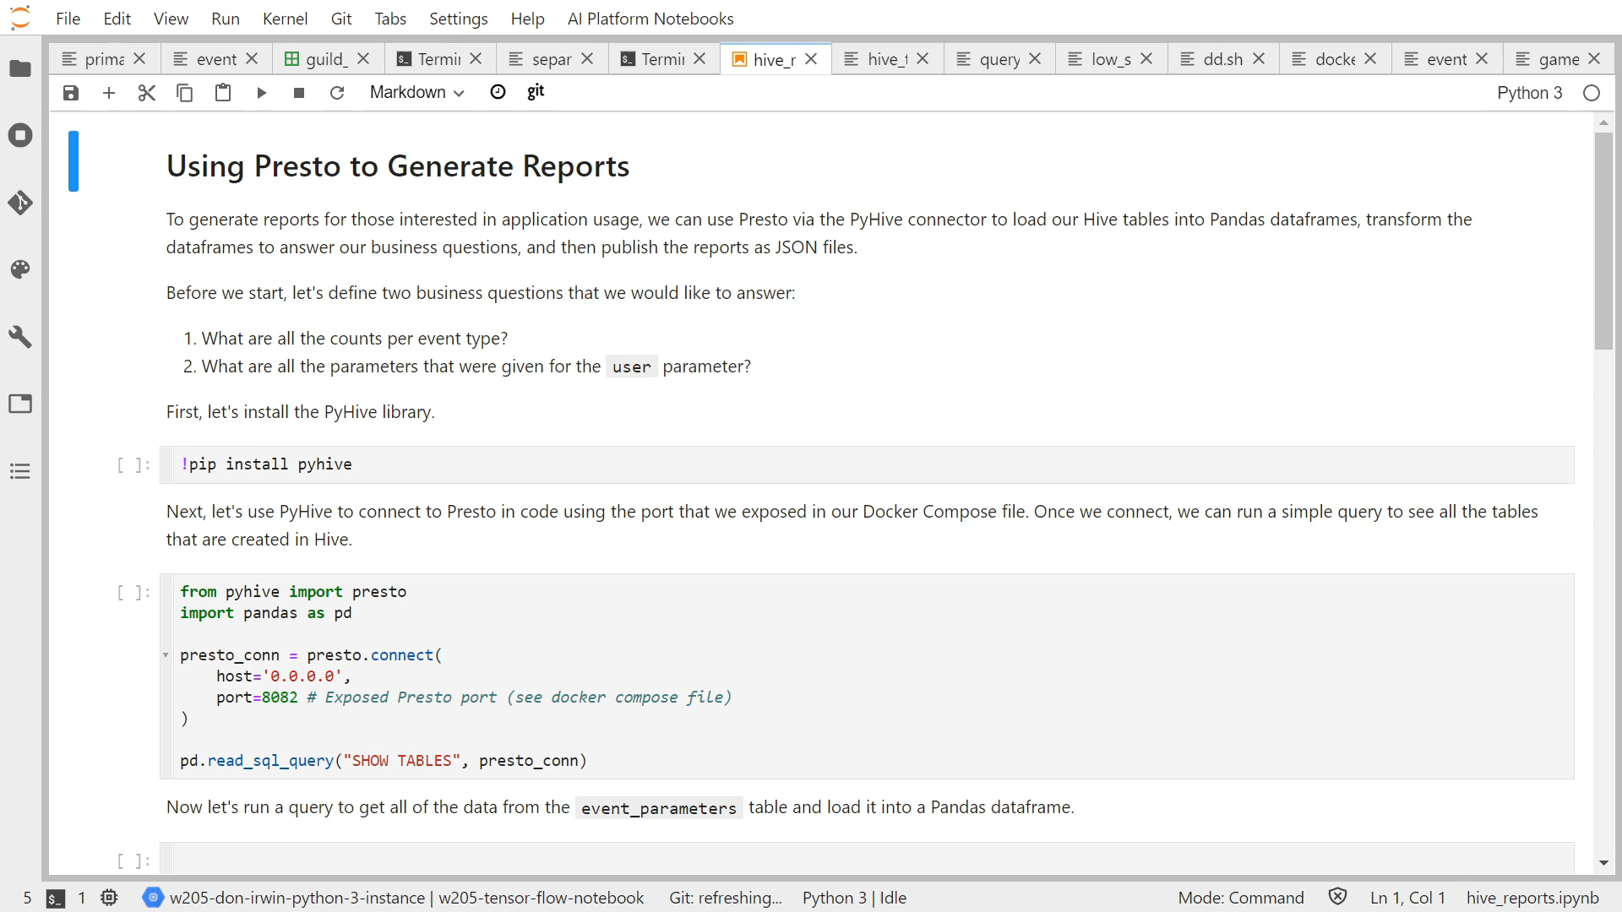
Querying Hive Tables – Jupyter Notebooks
MIDS 2021 Fall, W201 Project 2 The Low Stress Express
Notes:
Worker attrition is measured by participants moving between companies during the study. Worker productivity is revenue per hour of worker labor. Worker satisfaction will be measured by surveys before and after. Risks include changes to indexes of productivity, or retention due to mergers, recessions, etc. …

Slide 12
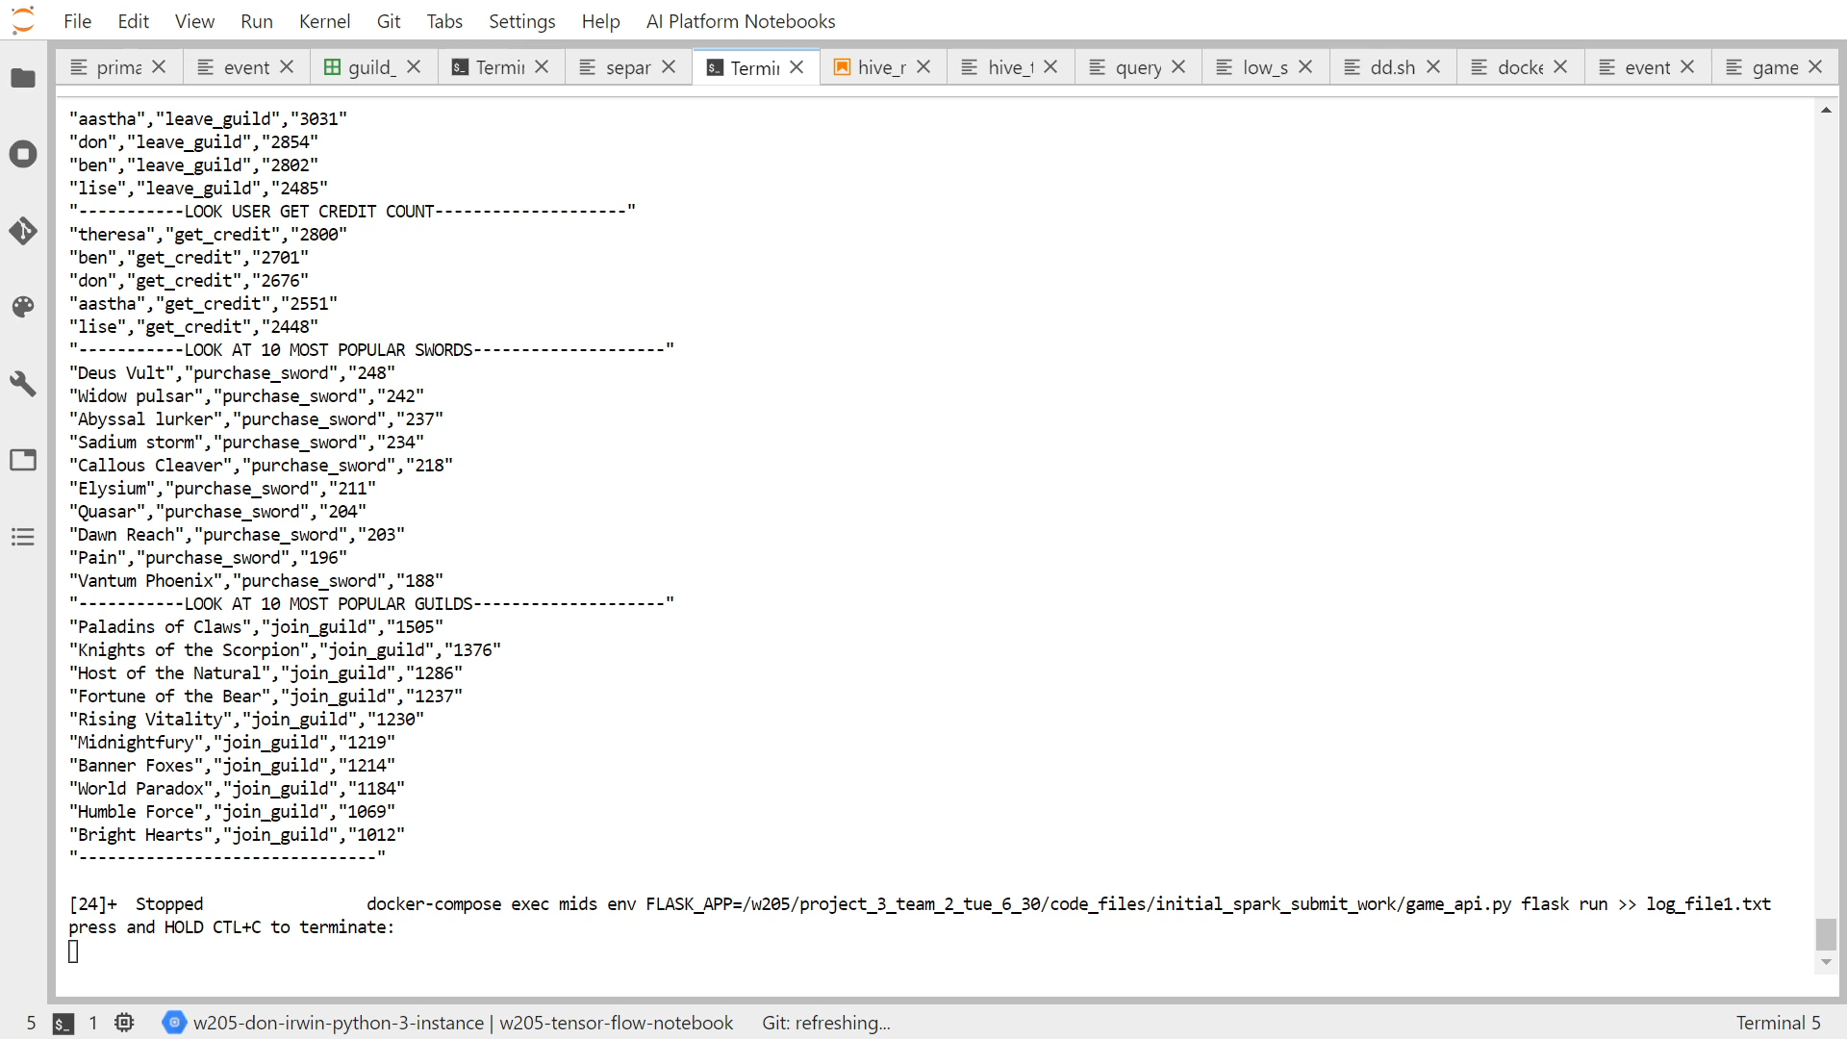
Scripting it All Together
MIDS 2021 Fall, W201 Project 2 The Low Stress Express
Notes:
Worker attrition is measured by participants moving between companies during the study. Worker productivity is revenue per hour of worker labor. Worker satisfaction will be measured by surveys before and after. Risks include changes to indexes of productivity, or retention due to mergers, recessions, etc. …

Slide 13
Conclusion
It takes a lot of work to make things look easy. That is the job persons of science undertake; diligent work to make complexity accessible to our teams and those we work with. We will now take questions.
MIDS 2021 Fall, W201 Project 2 The Low Stress Express
Notes:
Worker attrition is measured by participants moving between companies during the study. Worker productivity is revenue per hour of worker labor. Worker satisfaction will be measured by surveys before and after. Risks include changes to indexes of productivity, or retention due to mergers, recessions, etc. …

